Slide 1
SLINGZ
YGSS ADVERTISING

Slide 2
Slingz Laces
YGSS ADVERTISING
Slingz are silicone no tie waterproof laces that are mainly worn by kids and seniors but they can be used by any ages. Recently with YGSS advertising Slingz had been given a new advertising opportunity to market their product to Bethany students and parents.

Slide 3
Ygss ADVERTISING
SLINGZ STORY
“I STARTED SLINGZ FOR TWO REASONS: TO BE AN INDEPENDENT BUSINESS OWNER WITH THE END GOAL OF RETIRING AT AGE 50 AND WORKING MAX 5 HOURS A WEEK FROM ANYWHERE IN THE WORLD AND OF COURSE BECAUSE EVERYONE HATES SHOELACES!”
RISHI SONI

Slide 4
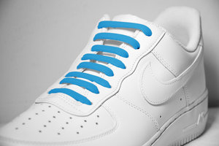
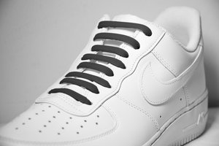
slingz are on sale for $5.97
Pricing

Slide 5
PROMOTION STRATEGY
YGSS ADVETISING
Visit www.slingzlaces.com to buy Slingz
Follow slingz on Instagram @slingzlaces
Follow slingz on Facebook @Slingz
Follow slingz on Twitter @slingzlaces
Subscribe to Slingz Laces on Youtube

Slide 6
Follow on Social media @
ygss
Youtube- Slingz Laces
Instagram- @slingzlaces
Twitter- @slingzlaces
Facebook- @Slingz

Slide 7
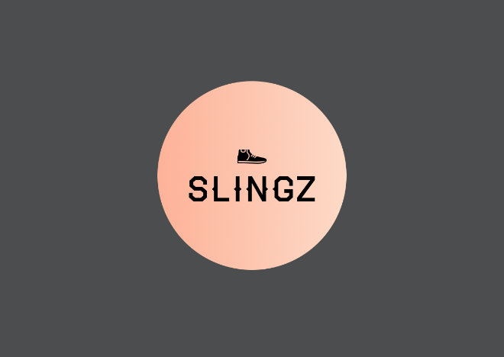

Slide 10
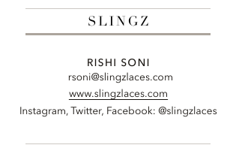
Business card

